Slide 1






Cover
Contents
Report
Ending
Writing Requirements for
Results & Conclusion
LET’S
BEGIN!
Presenter：丁涛
Date：11.20
Notes:
Good morning everyone. Today, I’m going to talk about the differences between the Results section and the Conclusion section in academic writing. Understanding this distinction is very important, because these two parts serve completely different purposes in a research paper.

Slide 2






THE CONTENTS
WAGE EARNER
Cover
Contents
Report
Ending
目录
01
02
03
04
Purpose
Content
Writing Style
Comparison
Notes:
Now let’s take a quick look at the contents of my presentation . I will introduce my topic from four aspects, and they are Purpose, Content, Writing Style, and Comparison.

Slide 3
Cover
Contents
Report
Ending
01
Purpose
ONE

Slide 4


Purpose
Results
Conclusion
Objectively
Summarize
Present findings objectively, without interpretation
Summarize major findings clearly
tables/figures
Significance
Use tables/figures to highlight data patterns
Explain academic or practical significance
Observed
Relate
Report only observed outcomes
Relate findings to research questions
Notes:
Whether it's the Results section or the Conclusion section, clarifying the purpose of writing is the first crucial step
.
For the Results section, the core purpose is to present research findings objectively without adding personal interpretations.
As for the Conclusion section, its purpose is quite different. It needs to:

Slide 5
Cover
Contents
Report
Ending
02
Content
TWO
Notes:
Now that we understand the writing purposes, let's move on to the second part: Content Composition.

Slide 6
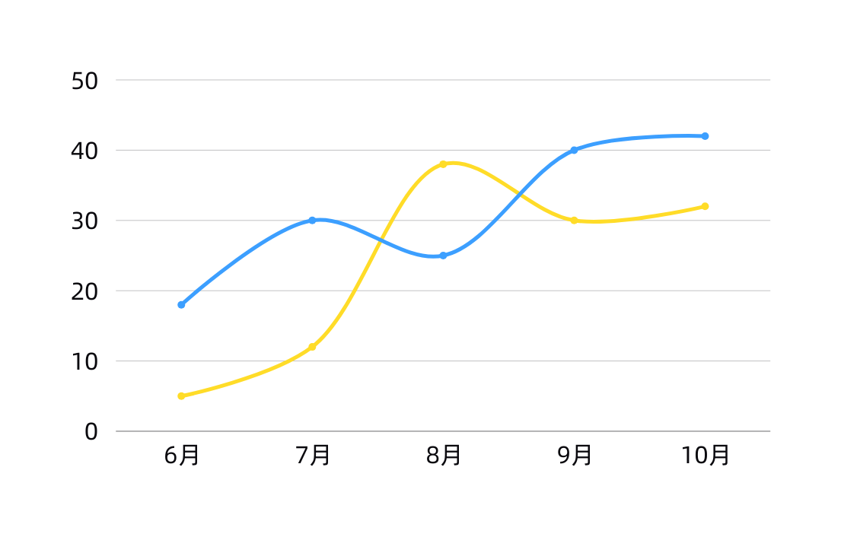
Content
Results Section Includes:
Numerical data (means, percentages, frequencies, trends)
Visual representations (tables, bar charts, line graphs)
Objective outcomes from experiments or surveys
Avoid in Result:
“This indicates…”
“This suggests…”
➡️ These belong to Discussion or Conclusion.
Notes:
Now let’s look at the second aspect: the content differences between the Results section and the Conclusion section.
In the Results section, the content mainly consists of objective information. This includes numerical data such as It also often includes other visuals that present the findings clearly. Most importantly, the Results section only reports what was found in the study or experiment.
However, the Results section should not include any analytical or interpretive language. For example, expressions like “This indicates…” or “This suggests…” should not appear here. These types of statements belong in the Discussion or the Conclusion, where the meaning and implications of the results are explained.
So, in short, the Results section presents the data, but does not explain it.

Slide 7
Cover
Contents
Report
Ending
03
Writing Style
THREE
Notes:
So,我们应该在实际写作中如何做呢？

Slide 8

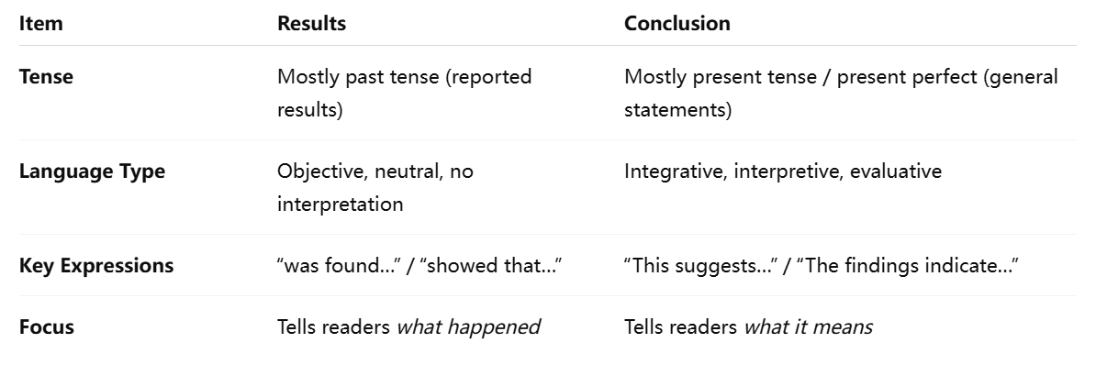
Writing Style
Notes:
项目ResultsConclusion语态多用过去时（reported results）多用现在时/现在完成时（general statements）语言类型客观、中性、不解释综合、解释、评价关键词“was found…” / “showed that…”“This suggests…” / “The findings indicate…”重点告诉读者发生了什么告诉读者其含义是什么

Slide 9



Small Result Examples
“The experimental group did much better, clearly showing improvement.”
“The experimental group scored significantly higher than the control group (M = 85.3 vs. 76.1, p < .05).”
Source: Smith, J. (2020). Research Methods in Applied Linguistics. Cambridge University Press.
Notes:
Improved Example is better because it is precise, objective, data-supported, and follows academic conventions. 📌 改进示例更好，因为它准确、客观、有数据支持，并遵循学术写作规范。

Slide 10
Small Conclusion Examples
“In conclusion, the results were interesting and useful.”
“The findings indicate that explicit vocabulary instruction improves learners’ reading comprehension.”
Source: Nation, I. S. P. (2013). Learning Vocabulary in Another Language. Cambridge University Press.
Notes:
Ask question This statement is too general and fails to specify the significance of the research results. An excellent expression, on the other hand, is
It clearly points out the specific value of the research findings.

Slide 11
Cover
Contents
Report
Ending
04
FOUR
Comparison

Slide 12
Comparison (Using “Attention Is All You Need” as an Example)
Results Section Example
“the big transformer model… outperforms the best previously reported models… achieving a BLEU score of 28.4.” （模型在英德翻译任务上取得 28.4 BLEU 分数）
Reports objective performance numbers.
No interpretation or discussion. (Source: Page 8, Results section)
Conclusion Section Example
“we presented the Transformer… achieving a new state of the art… we are excited about the future of attention-based models.” （我们提出 Transformer 并取得了新的 SOTA，对未来工作充满期待）
“We plan to extend the Transformer to other tasks… and to investigate local, restricted attention mechanisms…” （未来将拓展模型到其他任务，并探索新的 attention 机制）
Provides interpretation, significance, and future directions.
No numerical results. (Source: Page 10, Conclusion section)
Notes:
In its Results section, there is a statement like this:”
This part only reports objective performance data without any interpretation or discussion, which fully complies with the writing requirements of the Results section.
This part interprets the research results, explains the significance of the research, and points out future research directions, without involving specific numerical results. This is exactly what the Conclusion section should be like.

Slide 13
One-Sentence summary
Results = What you found (facts)
Conclusion = What your findings mean (meaning)
Notes:
In short, we can summarize it in one sentence: Results are what you found (facts), while Conclusion is what your findings mean (significance).

Slide 14


Cover
Contents
Report
Ending
Thanks
For Watching
presenter：丁涛
date：11.20
Notes:
That's all for today's sharing on "Writing Requirements for Results & Conclusion". I hope it will be helpful to you. Thank you for your listening!

